Slide 1
Teaching Deaf-Blind People to Communicate with the Public
Dona Sauerburger, COMS
March 26, 2026
Notes:
‹#›

Slide 2
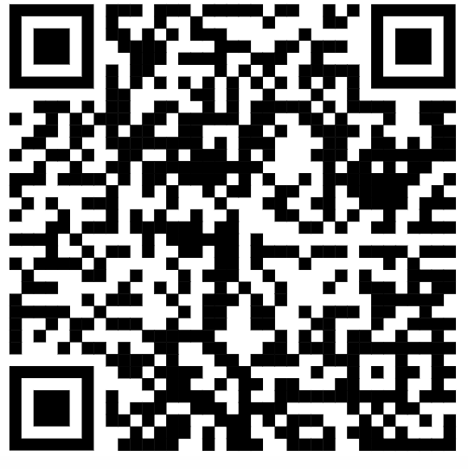
www.sauerburger.org/dona/dbcomm.htm
Teaching Deaf-Blind People to Communicate and Interact With the Public -- Critical Issues for Travelers Who Are Deaf-Blind JVIB 2005
Gene Bourquin and Dona Sauerburger

Slide 3
Communication techniques with the public
Expressive:
gestures
notes, cards, communication devices
Voice / recording
Symbols / pictures / map
Notes:
‹#›

Slide 4
Communication techniques with the public
Public response (MUST be explained to the public!)
Tap to alert they are ready to help
Write or spell
Speak
Yes-no signal
Action
Notes:
‹#›

Slide 5
Get out the popcorn, it’s time for VIDEOS! What communication strategies can you observe?

Slide 6
What communication strategies can you observe?
Expressive:
gestures
notes, cards, communication devices
Voice / recording
Symbols / pictures / map
Public response
Tap to alert they are ready to help
Write or spell
Speak
Yes-no signal
Action

Slide 7
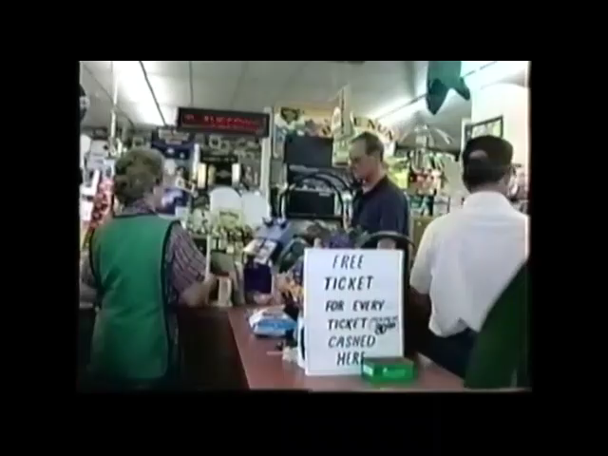

Slide 8
What communication strategies did you observe?
Expressive:
gestures
notes, cards, communication devices
Voice / recording
Symbols / pictures / map
Public response
Tap to alert they are ready to help
Write or spell
Speak
Yes-no signal
Action

Slide 9
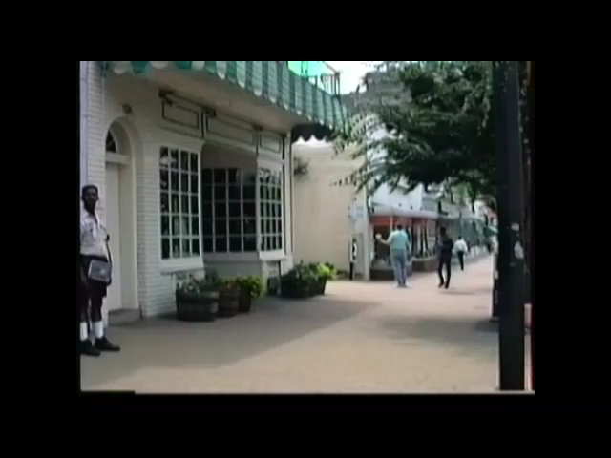
Notes:
‹#›

Slide 10
What communication strategies did you observe?
Expressive:
gestures
notes, cards, communication devices
Voice / recording
Symbols / pictures / map
Public response
Tap to alert they are ready to help
Write or spell
Speak
Yes-no signal
Action

Slide 11
Hurray! We’re done!
With appropriate communication strategies, and being skilled for using them, interaction will be smooth – you’re good to go, right?

Slide 12
NO! Things go wrong. ROUTINELY!!!!
Instructor’s role is crucial!
Otherwise, students can
not realize the public is clueless and assume public is being rude / hateful
become
disillusioned;
suspicious;
distrusting
Avoid going out in public

Slide 13
Teaching to communicate with public:
Explain communication methods
Student chooses (as many as possible!)*
Student becomes skilled
Student considers
what s/he needs
how to explain it to others
* You don’t know which is best, and you aren’t responsible to decide!
Student learns to prepare and organize for trips
“Principles for Successful Interaction”
Practice!
Start in structured (easy) situations
Advance to unstructured situations
Notes:
‹#›

Slide 14
Teaching to communicate with public:
Help me order these as to
structured (easy) situations AND
Communication partners who are willing, able and patient
Bus driver
Cleaners, post office
Grocery store
Large department store
Solicit aid to cross street
Solicit aid to find unfamiliar destination
Solicit aid when lost
Notes:
‹#›

Slide 15
Principles of
Successful Interaction with the Public
Notes:
‹#›

Slide 16
Principles of
Successful Interaction with the Public
Always assume that others
don't understand the situation and
don't know what to do
Explain it to them (repeatedly, if needed!).
Many will not understand the first time because they are
Dumfounded
weren't paying attention, or
incredulous.
Notes:
‹#›

Slide 17
Principles of
Successful Interaction with the Public
FAILSAFE:
have a way to recognize when the communication is not working
Notes:
‹#›

Slide 18
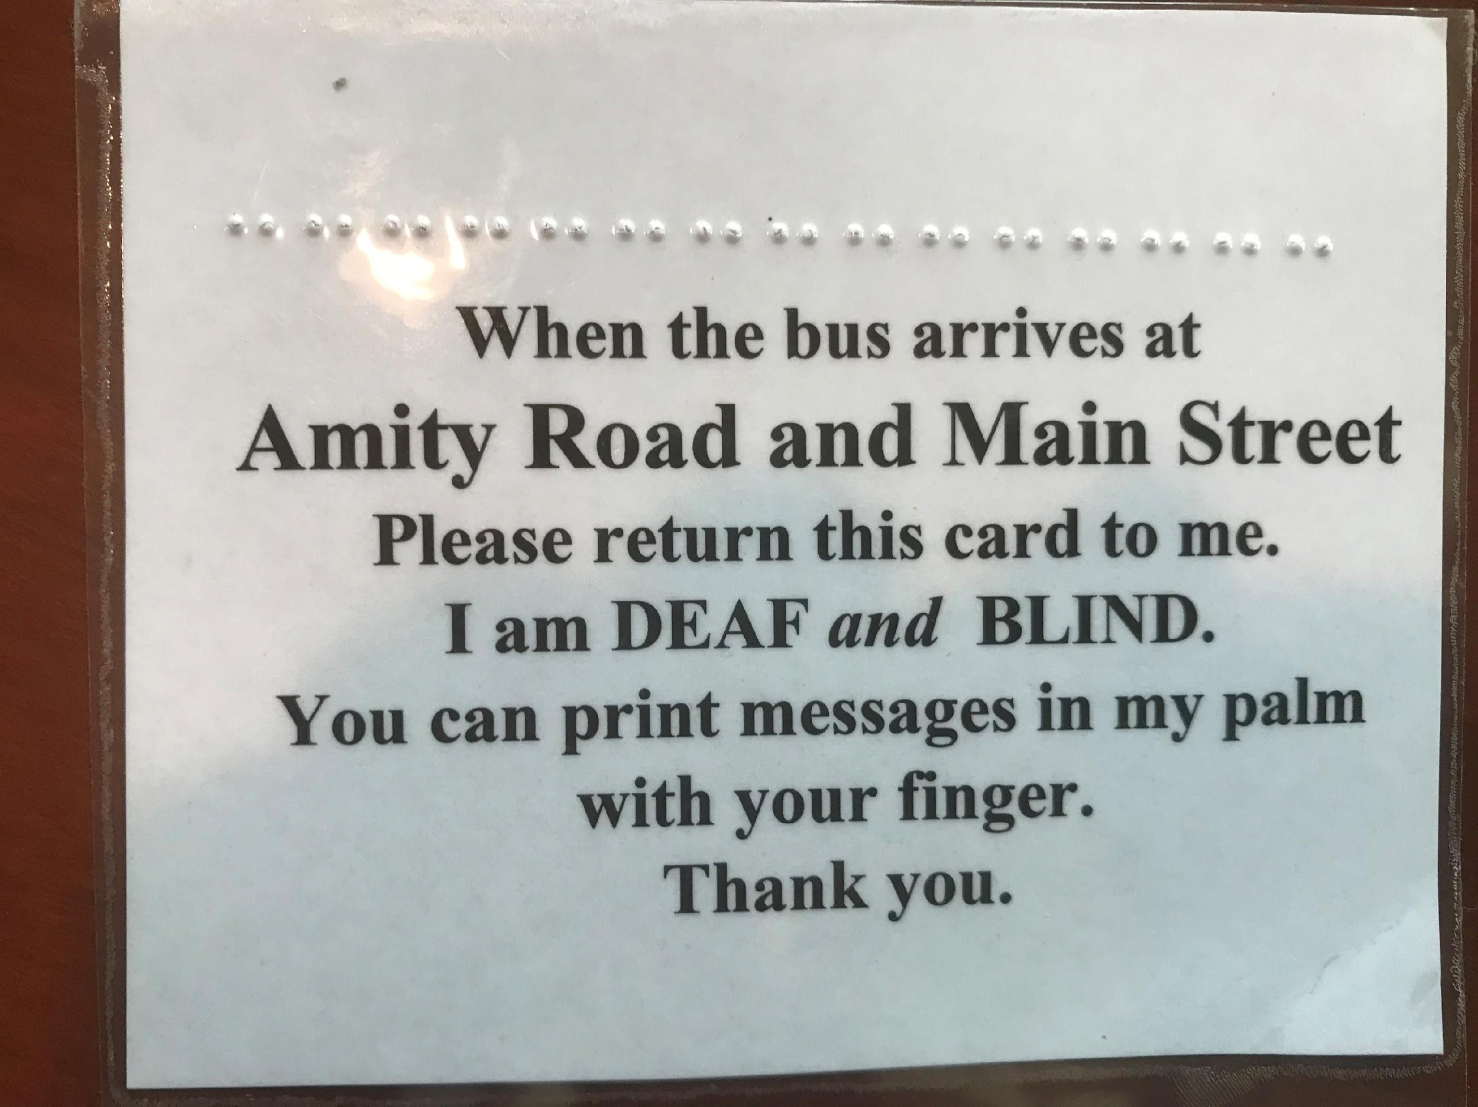
Principles of
Successful Interaction with the Public
When the bus arrives at
Amity Road and Main Street
Please return this card to me.
I am DEAF and BLIND
You can print messages in my palm
with your finger.
Thank you
Notes:
‹#›
Card says:
When the bus arrives at
Amity Road and Main Street
Please return this card to me.
I am DEAF and BLIND
You can print messages in my palm
with your finger.
Thank you

Slide 19
Principles of
Successful Interaction with the Public
BACK-UP PLAN
Always have back-up plan or alternative ways to communicate / get attention when the first attempt fails.
Notes:
‹#›

Slide 20
Principles of
Successful Interaction with the Public
FORCED-CHOICE communication option
Can expedite communication
Can simplify response
Notes:
‹#›

Slide 21
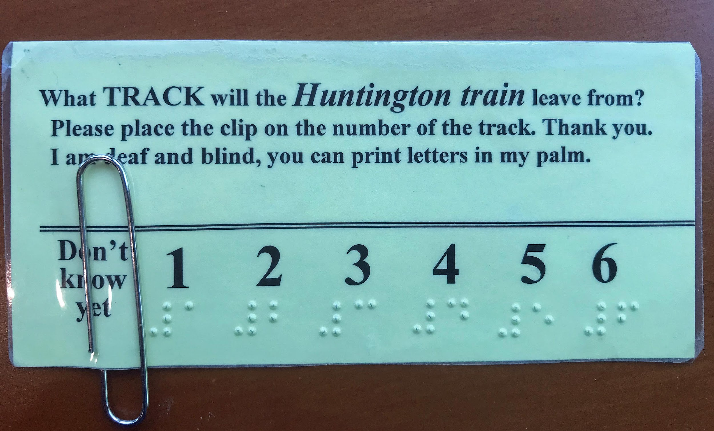
Communication techniques with the public
Card says “What TRACK will the Huntington train leave from?
Please place the clip on the number of the track. Thank you.
I am deaf and blind, ou can print letters in my palm.”
Below that is a row of numbers 1-6 in print and braille.
At the beginning of the row it says “Don’t know yet.”
There is a paper clip at the “Don’t know yet” note.
Notes:
‹#›
Card says “What TRACK will the Huntington train leave from?
Please place the clip on the number of the track. Thank you.
I am deaf and blind, ou can print letters in my palm.”
Below that is a row of numbers 1-6 in print and braille.
At the beginning of the row it says “Don’t know yet.”
There is a paper clip at the “Don’t know yet” note.

Slide 22
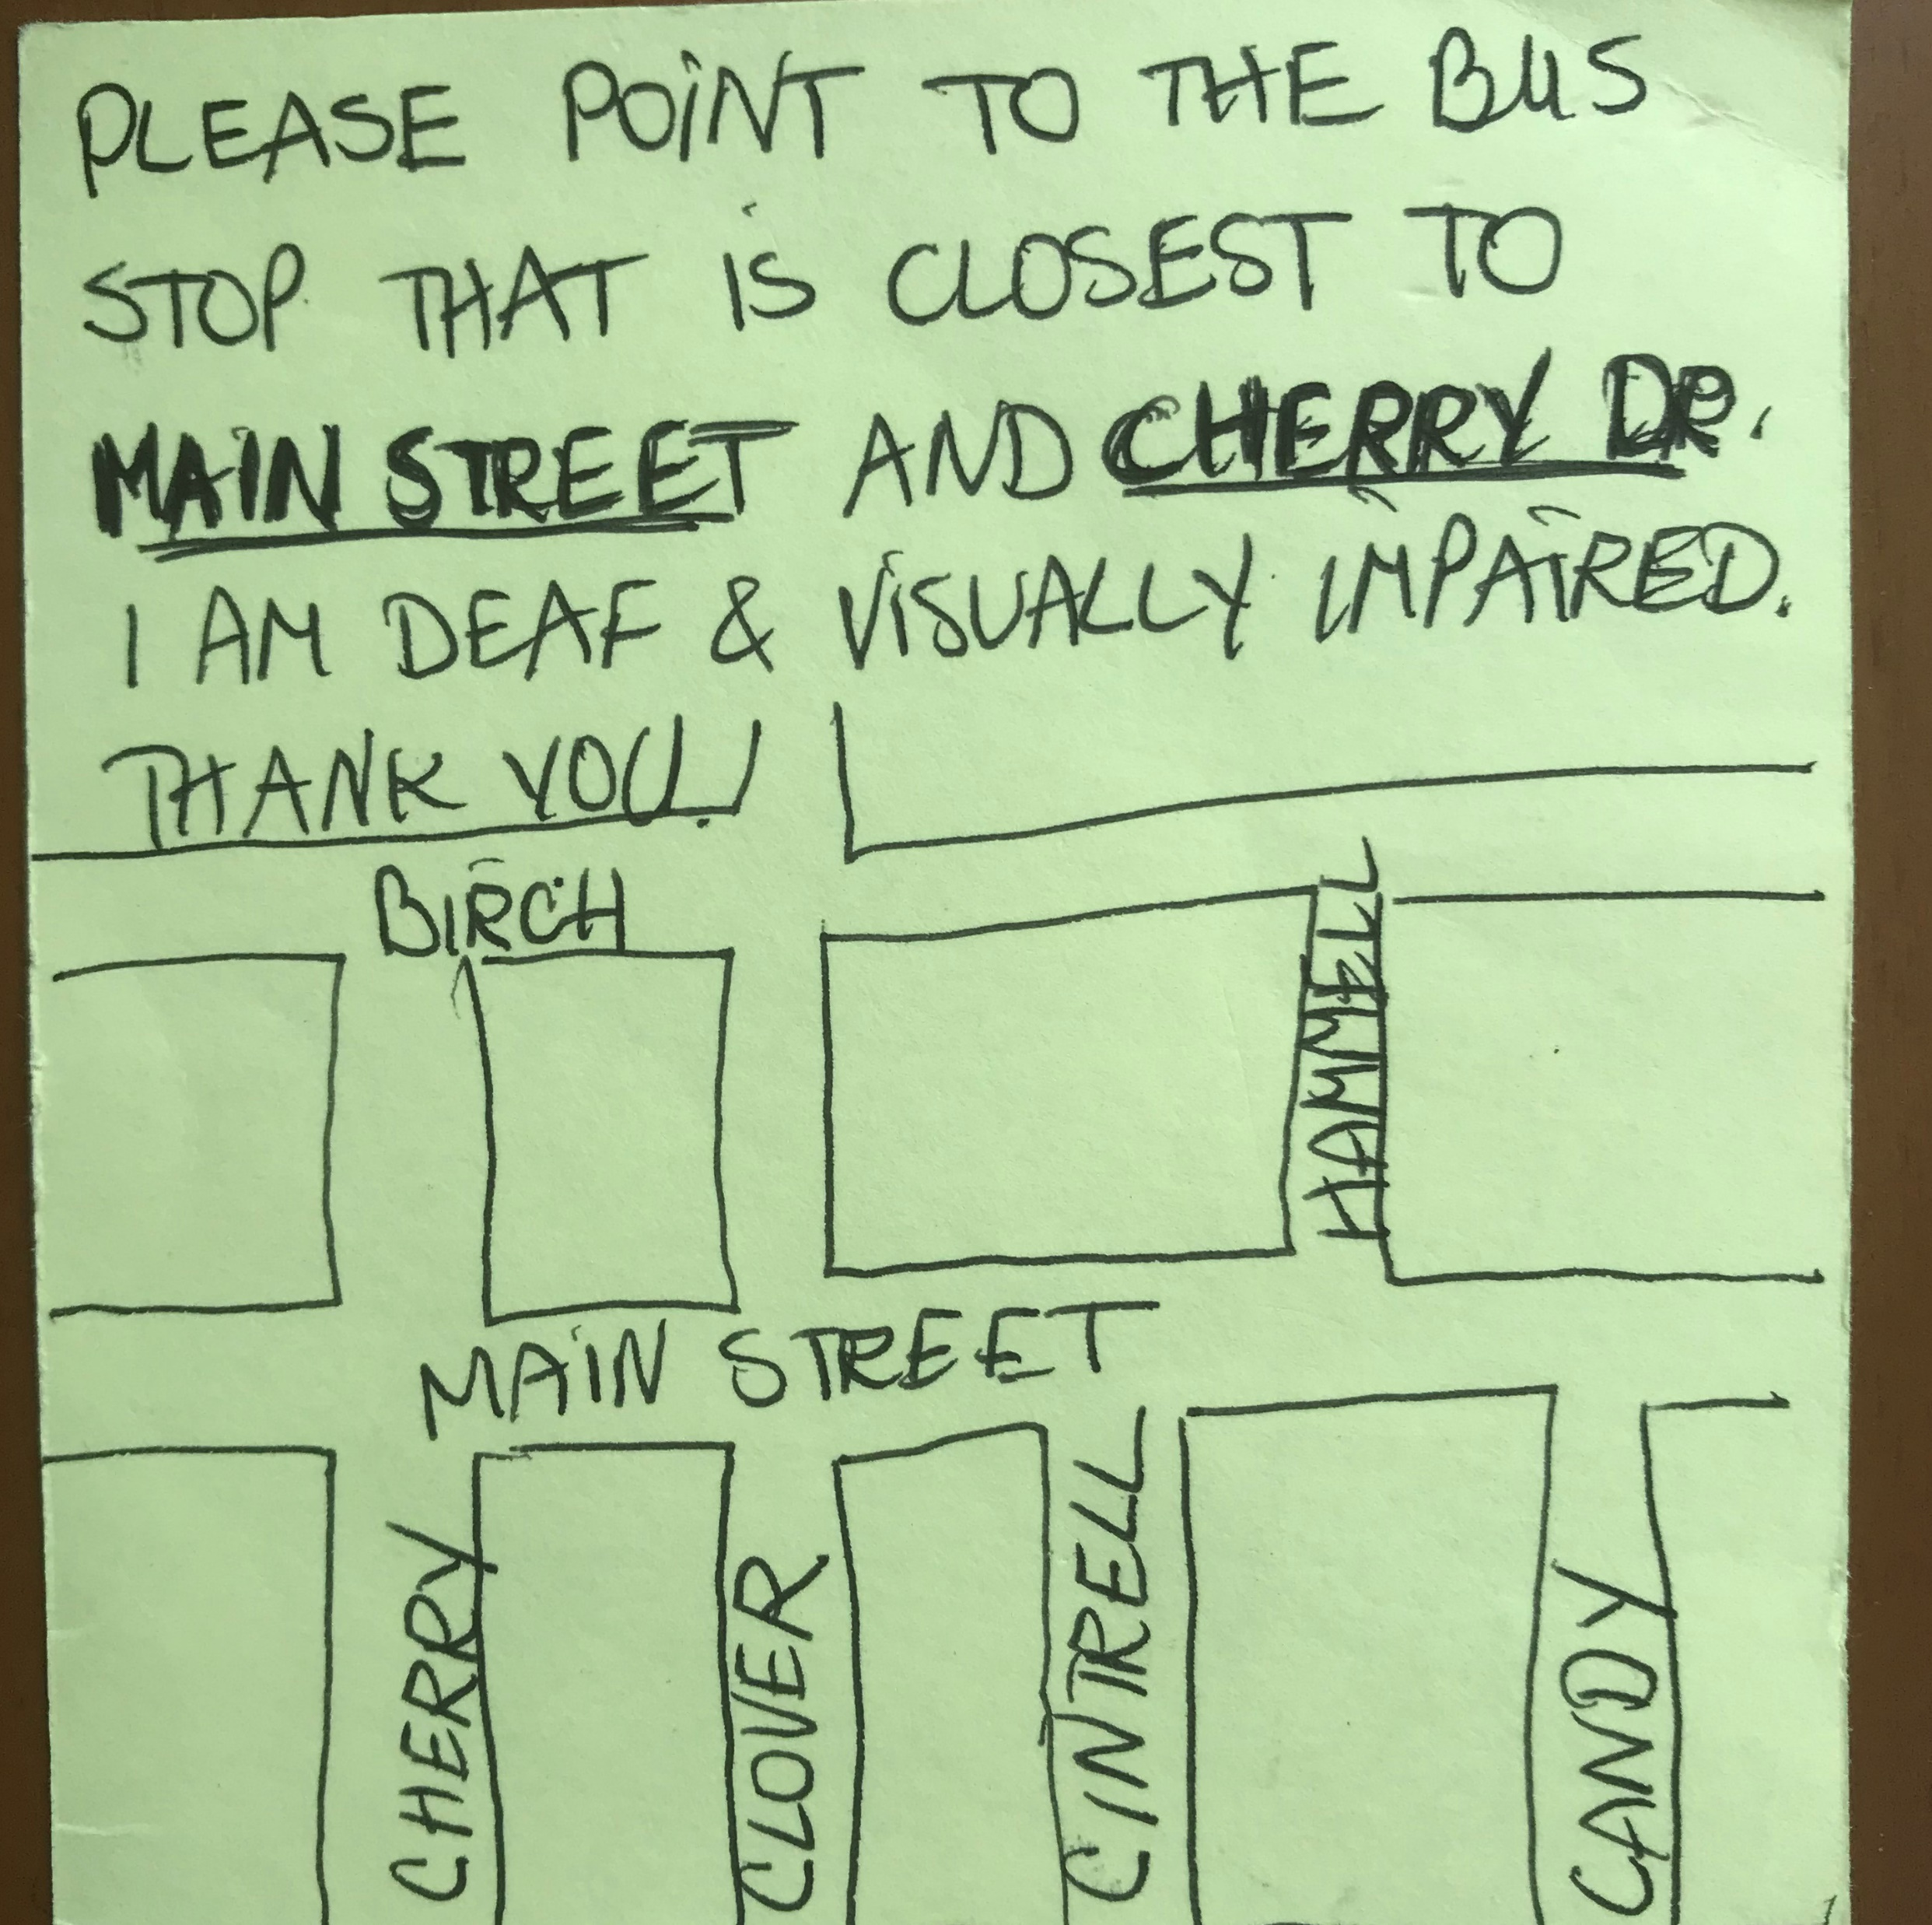
Can you think of other examples of forced-choice communication options?
Notes:
A map is drawn of two parallel streets and 4 intersecting streets labeled with their names.
The top of the card says, ‘Please point to the bus stop that is closest to Main Street and Cherry Drive.
I am deaf and visually impaired. Thank you.

Slide 23
Principles of
Successful Interaction with the Public
Know your needs and
how to advocate for them.
Notes:
‹#›

Slide 24
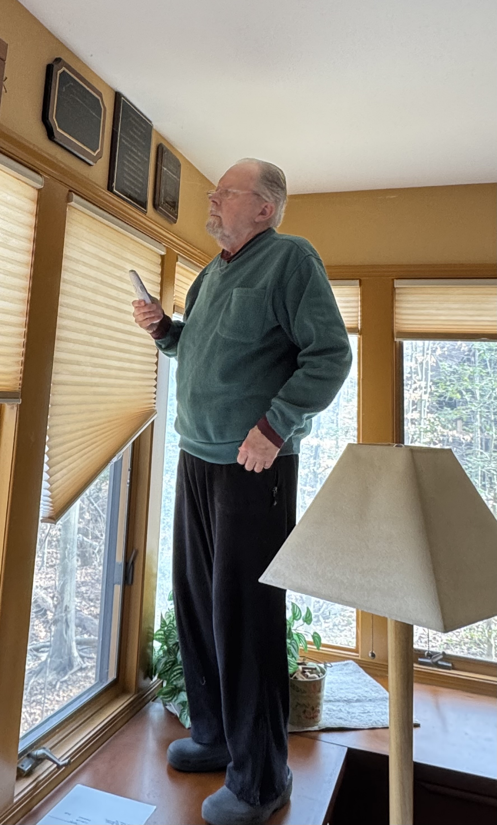
Principles of
Successful Interaction with the Public
Know your needs and
how to advocate for them.
Notes:
‹#›

Slide 25
Principles of
Successful Interaction with the Public
Know your needs and
how to advocate for them.
Notes:
‹#›

Slide 26
Principles of
Successful Interaction with the Public
always explain:
FIRST: what you want;
SECOND: what they can do to help
THIRD: your visual/hearing impairment
Notes:
‹#›

Slide 27
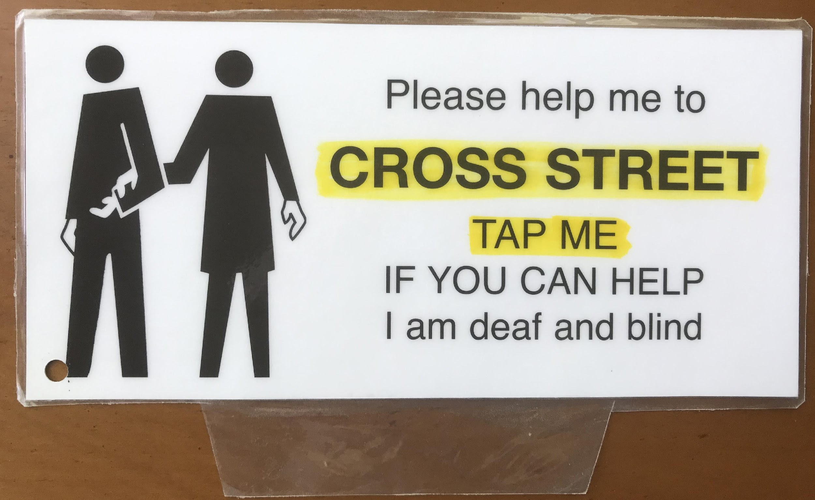
Principles of
Successful Interaction with the Public
always explain:
FIRST: what you want;
SECOND: what they can do to help
THIRD: your visual/hearing impairment
Notes:
‹#›

Slide 28
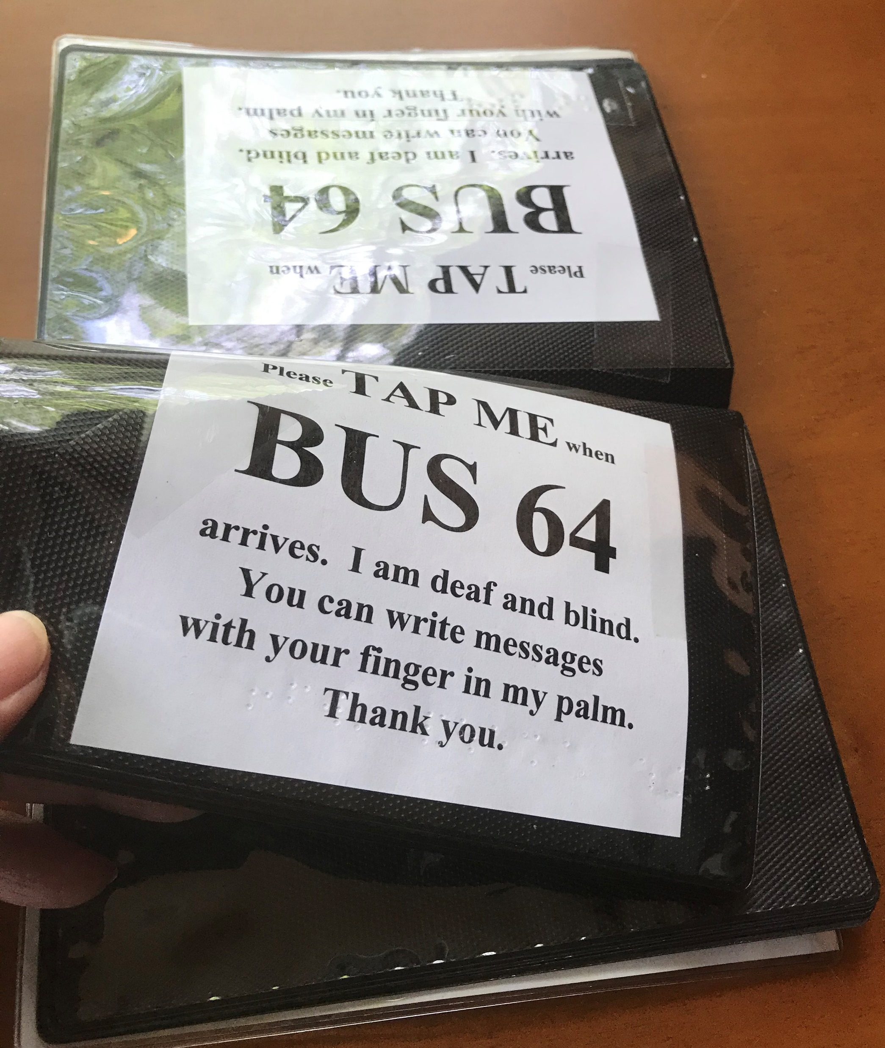
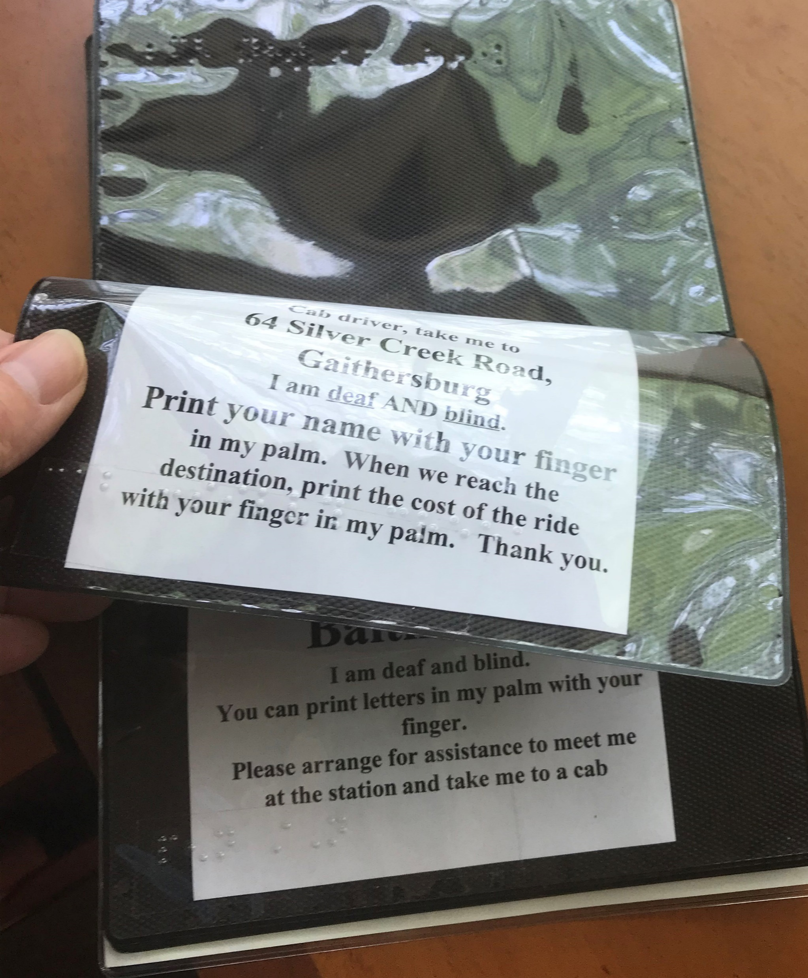
Prior to going out:
Student will:
plan every necessary communication
prepare notes / cards / equipment
organize them so they are easily usable
plan “back-up” for each communication task
brainstorm ways to get people's attention and assistance in each expected situation
Notes:
‹#›

Slide 29
Should the instructor increase chance of success by preparing the public?
What about giving the public some hints during the interaction?

Slide 30
After the experience:
Provide objective feedback about what was observed
Brainstorm to improve!
why did / didn’t the interaction work?
new ideas to improve and try next time
Notes:
‹#›

Slide 31
Jack is BACK!
How many back-up plans did he use?
Does his card follow principles?
what you want;
what they can do to help
your visual/hearing impairment
Feedback and brainstorm the session
(new ideas to improve and try next time)
Notes:
‹#›

Slide 32
